Slide 1
Indian Premier League (Cricket)
DATA ANALYSIS USING PYTHON (MILESTONE -- 1)
IPL cricket matches till season 9
Cricket matches between 2008 TO 2016

Slide 2
AIM OF THE PROJECT
Objective: To analyze the influence of various factors such as the toss, batting order, city and player performance on match outcomes in cricket.
Goals:
Determine how the toss decision affects match outcomes.
Identify the highest scoring teams and the distribution of runs across overs.
Analyze which players have won the most "Player of the Match" awards.
Perform a chi-square test to explore any relationship between the city and match winners.

Slide 3
DATA DESCRIPTION ( cd file)
match_id – unique id’s
Inning -- Tells if the first set of batting was going on or second. 1: First Innings 2: Second Innings
batting_team -- The team name which is currently batting.
bowling_team -- The team name which is currently bowling.
Over -- Describe the current over number
Ball -- Describe the current bowl no of the current over.
Batsman -- Name of the batsman on striking end.
non_striker -- Name of the batsman on non-striking end. Bowler , batsman_runs , extra_runs total_runs .

Slide 4
DATA DESCRIPTION ( dd file)
Season – no of years (2008 -- 2017)
City –This refers to the city where each match took place. It also indicates the total number of matches held in that city.
Team 1 -- The name of the first team that participated in the match.
Team 2 -- The name of the second team that participated in the match.
toss_winner -- The team that won the toss at the beginning of the match. In cricket, winning the toss gives the winning team the choice to bat or bowl first.
toss_decision -- The decision made by the team that won the toss, indicating whether they chose to bat first or bowl first.
Winner -- The team that won the match.
win_by_runs -- The margin of victory in terms of runs if the winning team won by this method. For example, if Team 1 won by 20 runs, this value would be 20.
win_by_wickets -- The margin of victory in terms of wickets if the winning team won by this method. For instance, if Team 1 won by 5 wickets, this value would be 5.
Player of match -- The player who was deemed the most outstanding performer in the match. This player’s performance was crucial to the outcome of the match.

Slide 5
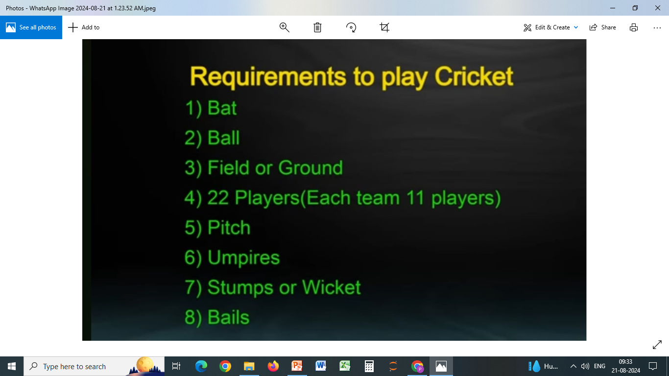

Slide 6
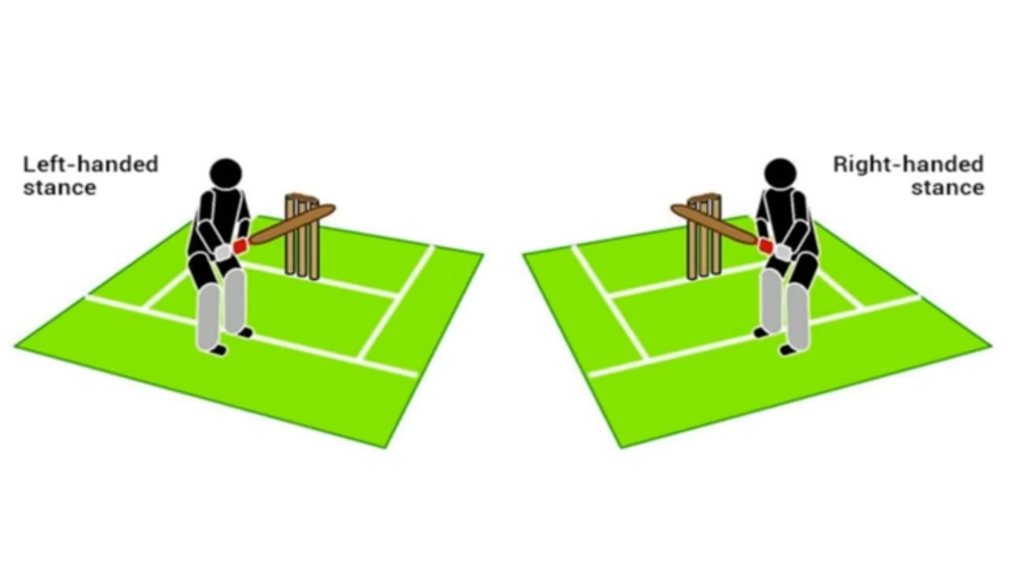
LEFT,RIGHT HANDED STANCE

Slide 7
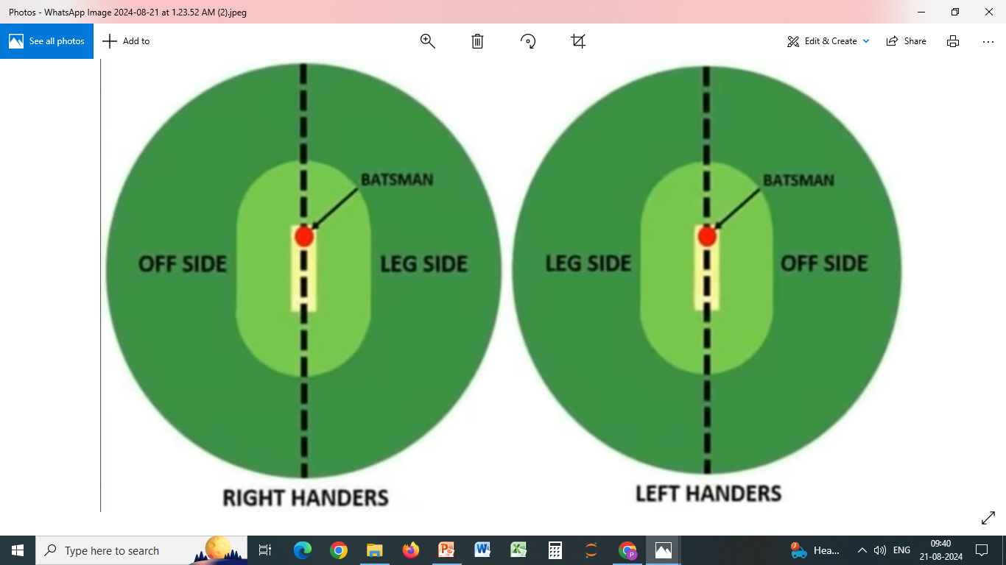

Slide 8
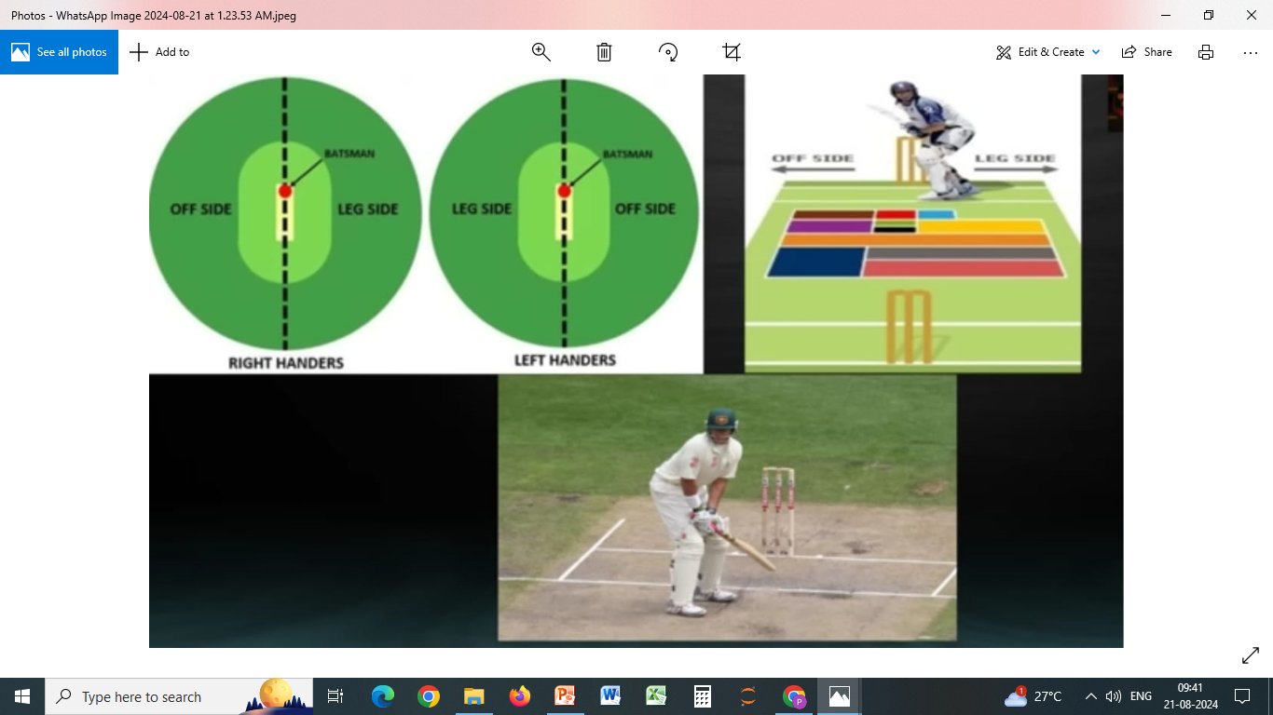

Slide 9
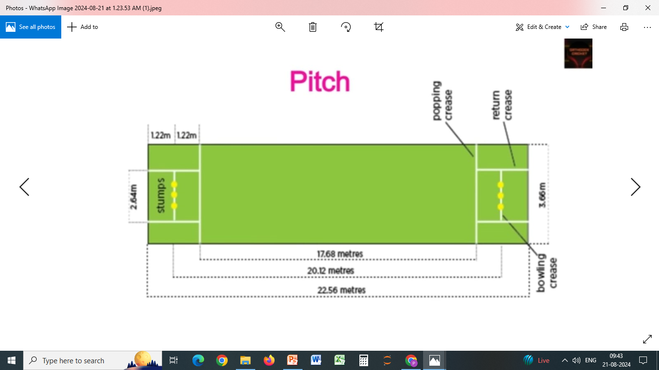

Slide 10
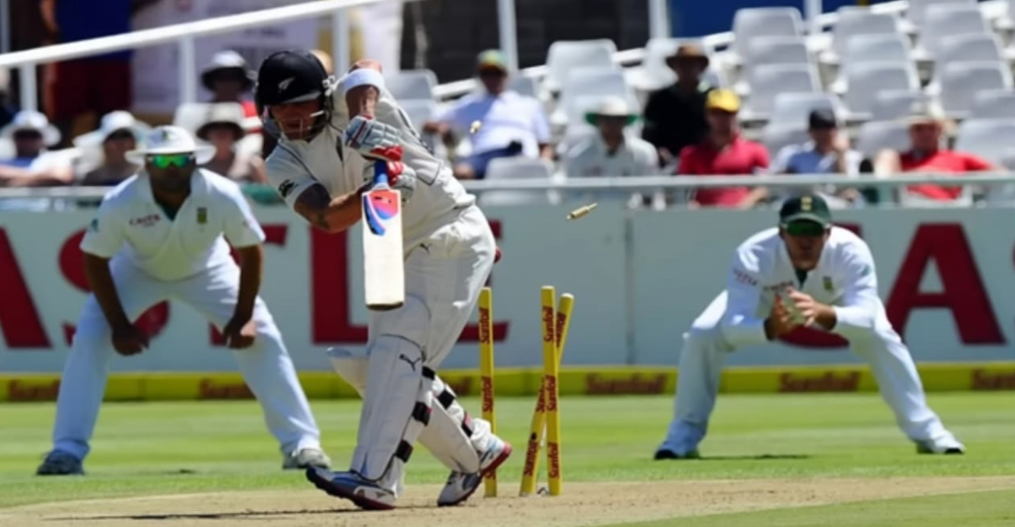

Slide 11
Business Problem or Problem Statement
Cricket is a sport where strategic decisions, such as whether to bat or bowl first, can have a significant impact on the outcome of a match. However, teams often face challenges in determining the best course of action based on historical data and current match conditions. One of the major challenges is understanding how the outcome of the toss influences the chances of winning, as well as identifying which teams perform better under specific conditions, such as batting first or chasing a target.

Slide 12
PROJECT DESCRPTION
The project also includes a detailed analysis of individual player performances, focusing on those who have won the "Player of the Match" award multiple times. By identifying these key players, the project highlights the individuals who consistently contribute to their teams' success.
Next, the project calculates the highest runs scored by teams in individual matches anPOd aggregates the total runs scored by each team across all matches in the dataset. This analysis provides a clear picture of the most prolific teams in terms of scoring.
Finally, a chi-square test is conducted to explore the relationship between the city where the match is played and the winning team. This statistical test helps determine whether certain locations are more favorable for specific teams, potentially due to home-ground advantages or other factors..

Slide 13
Code Implementation
Python
Exploratory Data Analysis (EDA)
Toss Influence
PandasMatplotlib
SeabornScipyalysisRun
Distribution Analysis Player
Performance Analysis
Chi-Square Test
Statistical Significance

Slide 14
STATISTICAL TESTS
CHI SQUARE TESTING
To assess if there is a significant association between the city and winner
p-Value : 8.258671120736886e-124
Degrees of Freedom (dof): 377
alpha = 0.05
Result :
Reject the null hypothesis at alpha = 0.05.
There is a statistically significant association between city and winner.

Slide 15
CONCLUSION
Analysis also indicates that some teams had a higher success rate in winning tosses, which contributed to their overall success. Additionally, the frequency of matches in each season highlights fluctuations in team performance over time. Teams with more consistent toss wins and the ability to set or chase high targets exhibited a greater likelihood of winning by runs or wickets. The 'Player of the Match' often came from teams that utilized toss advantages effectively. Overall, the data underscores the significance of toss decisions and batting first, revealing patterns that could inform future strategies for teams and analysts alike.

Slide 17


